Slide 1





Nikos misofis
Web Developer
@nikos-misofis
nikomiso92@gmail.com
@nikomiso
Hackathon Presentation

Slide 2
Project analysis and further implementation Sacchon - A Diabetes Management Web Application
Analysed current project
Created requirements
Specific changes of the project (github.com/nikomiso/codehub-sacchon)
TODO
BUG
Basic Validation (unique usernames and emails)
Correct exception/error messages
Reduce endpoints & make them simpler
GDPR compliance
Patient can add data to a different patient
Same password can't be added to another user
Nikos Misofis – Code.Hub | Pfizer Presentation

Slide 3

AWS Deployment Sacchon - A Diabetes Management Web Application
Nikos Misofis – Code.Hub | Pfizer Presentation

Slide 4
AWS Deployment Sacchon - A Diabetes Management Web Application
AWS - Public DNS
ec2-13-59-3-121.us-east-2.compute.amazonaws.com
Amazon RDS – SQL Server Endpoint
pfizersacchon.c3fw7ocmqcmk.us-east-2.rds.amazonaws.com
Nikos Misofis – Code.Hub | Pfizer Presentation

Slide 5

Frontend Testing - Postman Sacchon - A Diabetes Management Web Application
Nikos Misofis – Code.Hub | Pfizer Presentation

Slide 6
Frontend Testing - Postman Public and Protected endpoints
Public
Protected
/ping
/register
Patient
Doctor
Chief Doctor
Nikos Misofis – Code.Hub | Pfizer Presentation

Slide 7
Frontend Testing - Postman Public and Protected endpoints
GET Method
POST Method
Patient
Doctor
/patientSettings/{id}
/patient/{patientId}/carb/{carbId}
/patient/{patientId}/carb/
/patient/{patientId}/glucose/{glucoseId}
/patient/{patientId}/glucose/
/patient/{patientId}/consultation/{consultationId}
/patient/{patientId}/consultation/
/patientCarbDailyAverage/{patientId}
/patientCarbAverage/{patientId}
/patientGlucoseAverage/{patientId}
/doctor/{doctorId}/patient/
/doctor/{doctorId}/patient/{patientId}
/doctor/{patientId}/carb/
/doctor/{patientId}/glucose/
/doctorPatient/{patientId}/consultation/
/doctorPatient/{patientId}/consultation/{consultationId}
/doctor/{doctorId}/unconsultedPatients/
/doctor/{doctorId}/unconsultedPatient/{unconsultedPatientId}
/doctor/{doctorId}/needConsultationPatients/
/doctor/{doctorId}/needConsultationPatient/{needConsultationPatientId}
/doctor/{doctorId}/consultation/
/doctor/{doctorId}/consultation/{consultationId}
Nikos Misofis – Code.Hub | Pfizer Presentation

Slide 8
Frontend Testing - Postman Public and Protected endpoints
GET Method
POST Method
Chief Doctor
/chiefDoctor
/chiefDoctor/{id}
/patient
/patient/{id}
/doctor
/doctor/{id}
/carb
/carb/{id}
/glucose
/glucose/{id}
/consultation
/consultation/{id}
/reportPatientCarb/{patientId}
/reportPatientGlucose/{patientId}
/reportDoctorConsultation/{doctorId}
/reportUnconsultedPatient/
/reportUnconsultedPatientDiff/
/patientInactive
/doctorInactive
Nikos Misofis – Code.Hub | Pfizer Presentation

Slide 9
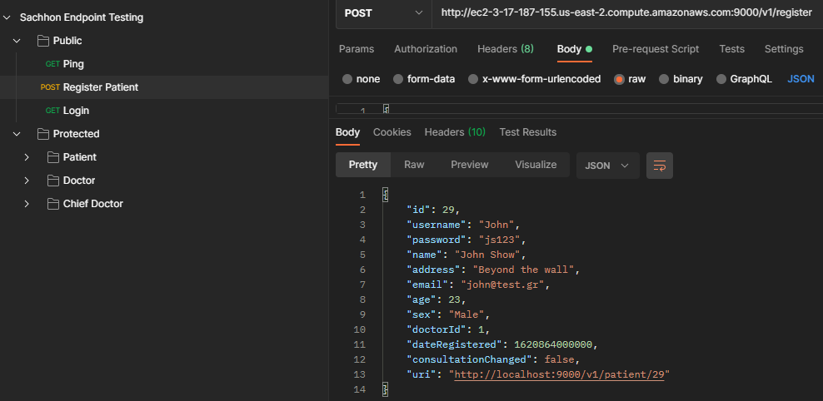
Frontend Testing - Postman Creation of a Patient
Nikos Misofis – Code.Hub | Pfizer Presentation

Slide 10
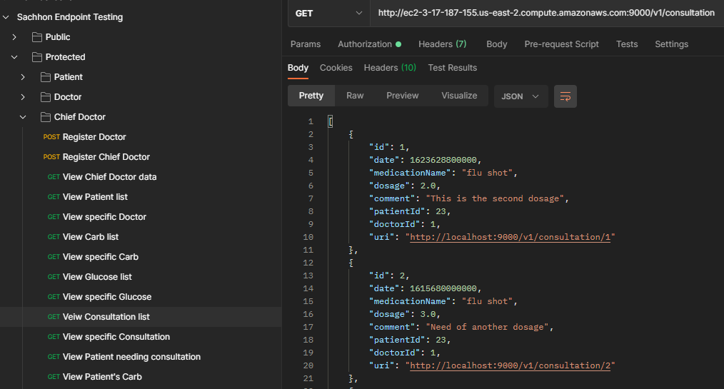
Frontend Testing - Postman Chief Doctors' list of all the consultations
Nikos Misofis – Code.Hub | Pfizer Presentation

Slide 11
Nikos misofis
Web Developer
@nikos-misofis
nikomiso92@gmail.com
@nikomiso
Thank You!
Any Questions?

